Slide 1
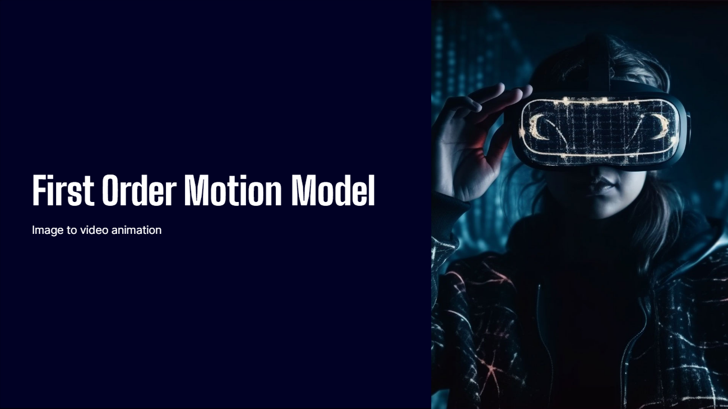

Slide 2
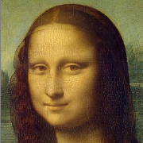

THINGS WE WILL LEARN
Input image
Animated image
Image animation consists of generating a video sequence so that an object in a source image is animated according to the motion of a driving video. It has multiple uses, such as in the fields of video games, movies,photography and virtual reality. We try to ensure that the image is animated in such a way that the movements appear natural and realistic. The framework uses a self-supervised formulation to decouple appearance and motion information which means it does not require any prior information or annotation about the specific object to animate

Slide 3
WHY FOMM ?
First Order Motion can be used to transfer facial expression of one human in a driving video to another source image of a human, previously Generative Adversarial Networks(GANs) and Variational Auto-Encoders (VAEs) were used. The drawback was these pre-trained models are expensive as they had to be manually labelled to ensure accurate information is provided.
This problem was tackled using a monkey net which was a self-supervised model which learns using keypoints and the source image is animated in accordance to the trajectories of these keypoints. This model fails to provide a good quality animations specially in cases where there is a large change in the objects pose. Thus often leading to poor quality of animated image
By understanding the difficulties being faced first order motion model was created which took good care of all of the above problems.

Slide 4
First Order Motion Model
Local Affine Transformation
Training losses
Testing Stage
Occlusion Aware Image Generation

Slide 5
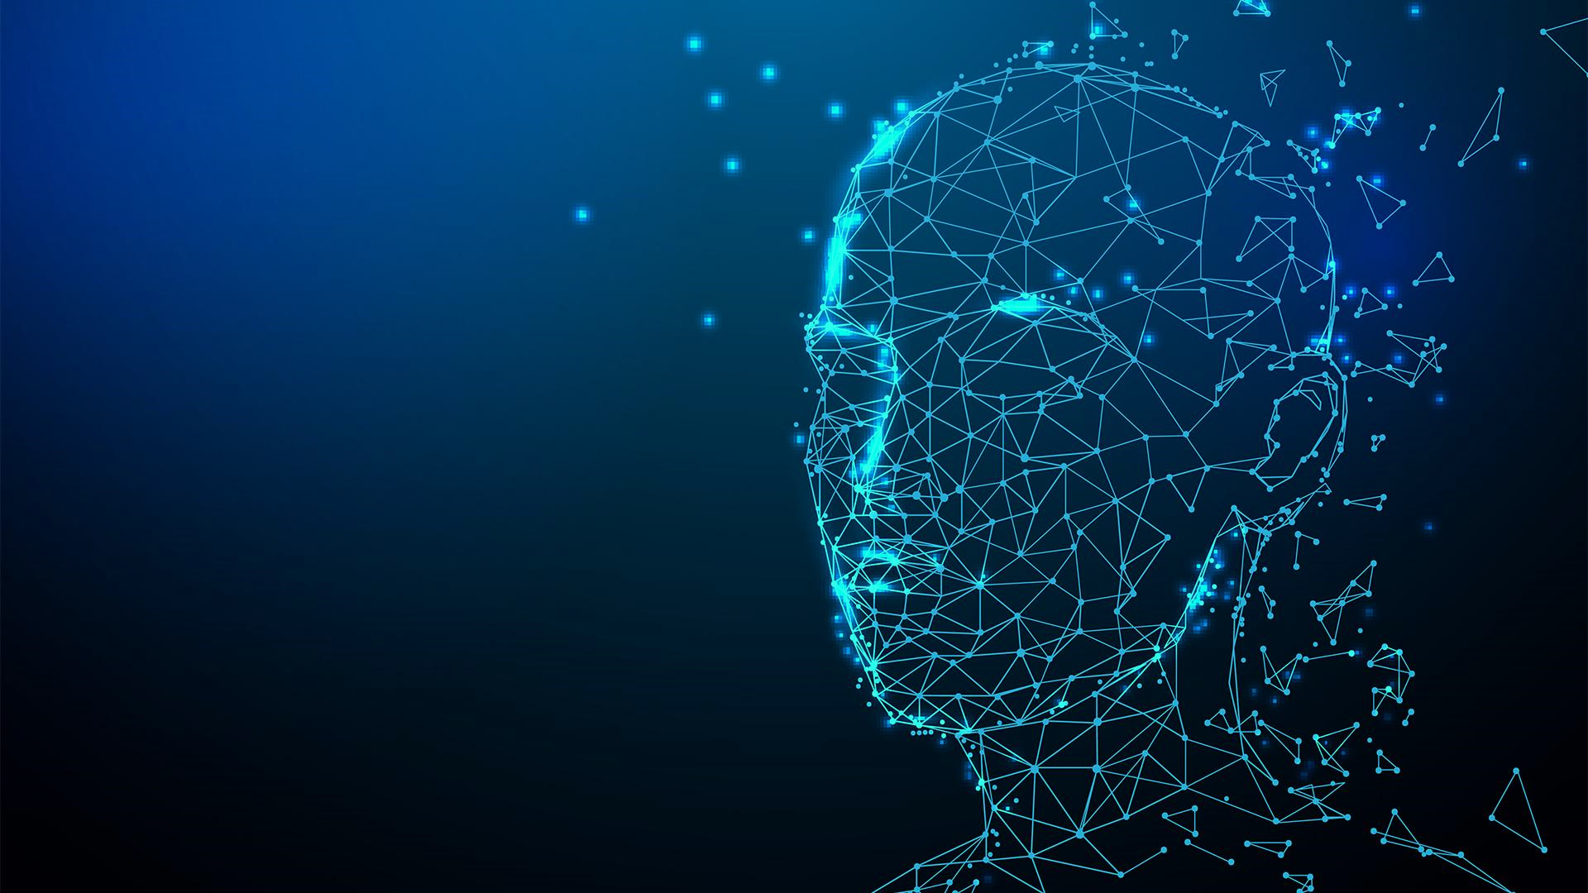
GENERAL METHODOLOGY
Training of this model uses a large collection of video sequences with objects of the same category and reconstructing the training videos by combining a single frame and a learned latent representation of motion
The approach consists of two main modules: the motion estimation module and the image generation module.
The motion estimation module predicts a dense motion field from the driving video to the source frame using backward optical flow and estimates transformations from an abstract reference frame to the source frame and driving video.
The generation module uses a generator network to warp the source image according to the dense motion field and inpaints the occluded parts.

Slide 6
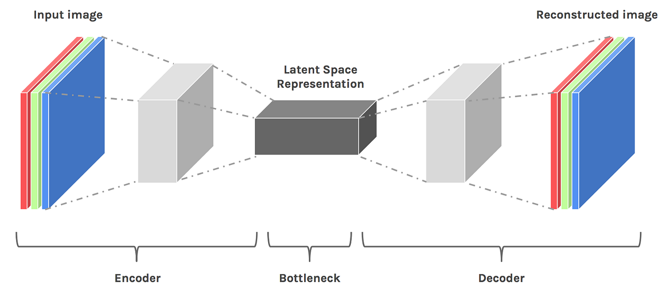
MOTION ESTIMATION
The locations of the keypoints in the driving video (D) and the source image (S) are separately predicted by an encoder-decoder network.
The keypoints act as a bottleneck and result in a compact motion representation. This sparse motion representation is well-suited for animation, as the keypoints of the source image can be moved using the keypoints trajectories in the driving video during testing.
Motion in the neighborhood of each keypoint is modeled using local affine transformations. Compared to using keypoint displacements only, the local affine transformations allow for modeling a larger family of transformations.

Slide 7
MOTION GENERATION
During the second step, a dense motion network combines the local approximations to obtain the resulting dense motion field T_{S←D}.
The dense motion network takes the local approximations of the motion field and combines them to generate a dense motion field between the source image (S) and the driving video (D)
In addition to the dense motion field, this network outputs an occlusion mask O_{S←D} that indicates which image parts of D can be reconstructed by warping of the source image and which parts should be inpainted, i.e. inferred from the context.
The network also generates an occlusion mask that identifies which parts of the driving video (D) can be reconstructed by warping the source image (S) and which parts need to be inpainted. This occlusion mask helps in determining the areas that require additional information from the context.

Slide 8
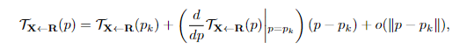
..
LOCAL AFFINE TRANSFORMATION
The motion estimation module estimates the backward optical flow T_{S←D} from a driving frame D to the source frame S. We approximate T_{S←D} by its first order Taylor expansion in a neighborhood of the keypoint locations.
We assume an abstract reference frame R. Then for estimating T_{S←D} we first estimate T_{R←D} and then we estimate T_{S←R} .
Now given a frame X, we estimate each transformation by considering its first order Taylor expansions in K keypoints p1​,…pK​.
p1​,…pK​ denote the coordinates of the keypoints in the reference frame R.
The point locations in the reference pose space are denoted by ’p’ while the point locations in the X,S or D pose spaces are denoted by ’z’
The equation can be used to estimate the local affine transformations for approximate motion description.

Slide 9
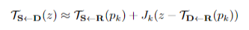
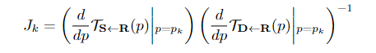
First we estimate the transformation T_{R←D}​ near z_{k}​ in D , followed by the transformation T_{S​ ←R} near the corresponding keypoint location p_{k} in R.
Finally, the transformation T_{S​ ←D} is obtained by combining the two transformations using the equation: T_{S​ ←D} = T_{S​ ←R} ∘ T_{R←D .} Which can be rewritten as : T_{S​ ←D} = T_{S​ ←R} ∘ T⁻¹_{D←R}
The first order Taylor expansion in the above equation is computed to obtain an approximation of the transformation T_{S←D}​​(z) near z_{k}​ in D. The equation is:
Where J_{k} is a matrix obtained by:
Then the network employs the U-Net architecture to estimate K heatmaps, one for each keypoint, and the last layer of the decoder uses softmax activations to predict heatmaps that can be interpreted as keypoint detection confidence maps.
The expected keypoint location is estimated using the average operation

Slide 10
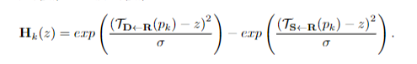
The transformation maps each pixel location in the driving video D with its corresponding location in S, but the local patterns in the estimated transformation are pixel-to-pixel aligned with D and not with S, making the task harder for the network to predict the transformation from S. To make this easier we roughly align it with the estimated transformation, the source S is warped according to local transformations estimated
K transformed images S1,...,SK are obtained, each aligned with the estimated transformation in the neighborhood of a keypoint. An additional image S₀=S is considered for the background.
Heatmaps H_{k} are computed for each keypoint p_{k}, indicating to the dense motion network where each transformation happens. Each H_{k} (z) is implemented as the difference of two heatmaps centered in T_{D←R}(p_{k}) and T_{S←R}(p_{k}).

Slide 11
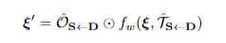
OCCLUSION AWARE IMAGE GENERATION
After two down-sampling convolutional blocks, a feature map ξ ∈ R ^{H′×W′} is obtained.
The feature map ξ is warped according to T_{S←D} using the back-warping operation denoted by f_{w}​ (⋅,⋅) .
An occlusion map O_{S←D} ​∈ [0,1]^{H′×W′} is introduced to mask out the feature map regions that should be inpainted due to occlusions in S.
The transformed feature map ξ is obtained by applying the Hadamard product ⊙ between the occlusion map and the warped feature map.
The transformed feature map ξ is fed to subsequent network layers of the generation module to render the sought image

Slide 12

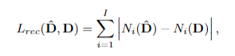
TRAINING LOSSES
The system is trained in an end-to-end fashion using several losses.
The main driving loss is the reconstruction loss based on the perceptual loss using the pre-trained VGG-19 network.
The reconstruction loss is calculated between the input driving frame D and the corresponding reconstructed frame D^. It is written as:
where N_{i​}(⋅) is the i^{th} channel feature extracted from a specific VGG-19 layer and I is the number of feature channels in this layer.
The resolutions used are 256×256 ,128×128 ,64×64 and 32×32 resulting in a total of 20 loss terms.
The use of multiple resolutions helps to capture details at different scales and improve the overall quality of the generated videos.

Slide 13
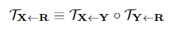
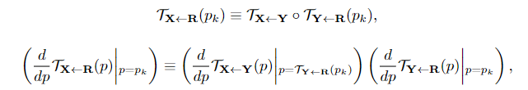
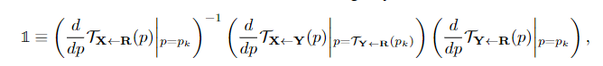





EQUIVARIANCE CONSTRAINT
The equivariance constraint forces the model to predict consistent keypoints with respect to known geometric transformations.
The thin plate splines deformations are used as they were previously used in unsupervised keypoint detection and are similar to natural image deformations.
The motion estimator predicts not only the keypoints but also the Jacobians.
The standard equivariance constraint is:
After the first order Taylor expansions of both sides, we obtain the following constraints:

Slide 14
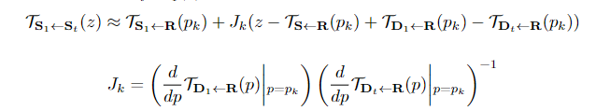
The goal is to animate an object in a source frame S1​ using the driving video D1​,…DT​.
Instead of transferring the motion encoded in T_{S1​←Dt}​​ (p_{k​}) to S, the relative motion between D1​ and Dt​ is transferred to S1​.
The neighbourhood of each keypoint p_{k}​ in S1​ is transformed according to its local deformation in the driving video.
Transferring relative motion over absolute coordinates allows to transfer only relevant motion patterns, while preserving global object geometry.
One limitation of transferring relative motion is that it assumes that the objects in S1​ and D1​ have similar poses.
Without initial rough alignment, may lead to absolute keypoint locations physically impossible for the object of interest.
TESTING STAGE

Slide 15

DATASET
The paper uses four different datasets for training and testing their method of image animation.
The VoxCeleb dataset is a collection of 22,496 YouTube videos that are pre-processed by extracting bounding boxes and cropping frames. The dataset contains 12,331 training videos and 444 test videos.
The UvA-Nemo dataset is a facial analysis dataset consisting of 1,240 videos. It undergoes the same pre-processing as VoxCeleb and is divided into 1,116 training videos and 124 evaluation videos.
The BAIR robot pushing dataset includes 42,880 training videos and 128 test videos of a robotic arm pushing objects on a table. Each video is 30 frames long with a resolution of 256x256.
The Tai-Chi-HD dataset is created by collecting 280 tai-chi videos from YouTube, with 252 videos used for training and 28 for testing. The videos are split into short clips, resized to 256x256 pixels, and result in 3,049 training and 285 testing video chunks

Slide 16
METRICS
Monkey-Net proposes metrics for evaluating video reconstruction, which are:
L1 Distance:
This metric evaluates the overall quality of the generated video.
The L1 distance is the average distance between the generated and ground-truth videos.
Average Keypoint Distance (AKD):
AKD is used to evaluate whether the motion of the input video is preserved.
The detected keypoints are independently computed for each frame, and AKD is obtained by computing the average distance between the detected keypoints of the ground truth and the generated video.
Missing Keypoint Rate (MKR):
This metric assesses the appearance quality of each generated frame.
MKR is defined as the percentage of keypoints that are detected in the ground truth frame but not in the generated one.
Average Euclidean Distance (AED):
AED is used to evaluate the quality of the generated frame representation.
An externally trained image representation is considered, and the average euclidean distance between the ground truth and generated frame representation is reported.

Slide 17

CONCLUSION
In conclusion, the First Order Motion Model, rooted in optical flow, pose estimation, and deep neural networks, represents a groundbreaking advance in animation and computer vision. It seamlessly merges source video motion with the appearance of a target image, unlocking creative possibilities in video editing and character animation. While offering transformative potential, its responsible application is essential. Privacy concerns and ethical considerations must be addressed in the era of deepfakes. Striking a balance between innovation and ethics is paramount. In the coming years, the First Order Motion Model is poised to reshape animation and video synthesis, ushering in a new era of visual media while demanding responsible usage.

